Slide 1
Cloud Computing Tutorial
Christophe Poulain
Yogesh Simmhan
Bora Beran

Slide 2
Introduction to Cloud Computing
IT resources provided as a service
Compute, storage, databases, queues
Clouds leverage economies of scale of commodity hardware
Cheap storage, high bandwidth networks & multicore processors
Geographically distributed data centers
Offerings from Microsoft, Amazon, Google, …

Slide 3
Introduction to Cloud Computing
Cost & management
Economies of scale, “out-sourced” resource management
Reduced Time to deployment
Ease of assembly, works “out of the box”
Scaling
On demand provisioning, co-locate data and compute
Reliability
Massive, redundant, shared resources
Sustainability
Hardware not owned

Slide 4
Introduction to Cloud Computing
Improves usability
For eScience developers
Simple API, service platform
Quick & scalable provisioning
Hides the complexity of distributed applications, hardened services with guarantees
For users
Lightweight security model
Desktop feel in a browser
Simple management & quotas
Time spent on science rather than engineering

Slide 5
Azure Goals
A Flexible Services Platform with Internet Scale
Simple scenarios are simple – complex scenarios are possible
Services hosted in Microsoft’s data centers
Designed for high availability & scalability
Based on Internet Standards
Multiple protocol support including HTTP, REST, SOAP, AtomPub
Broad investment in open, community-based access to Azure services
Easy adoption
Familiar tools, languages, and frameworks with .NET and Visual Studio
Provides the choice to build on-premises, cloud, or hybrid solutions
Integrate with existing assets such as AD and premises applications

Slide 6




What does Azure platform offer to developers?
Your Applications
…
Service Bus
Workflow
Database
Analytics
Identity
Contacts
Access Control
…
Reporting
…
Devices
…
Compute
Storage
Manage
…

Slide 7









Azure™ Services Platform

Slide 8





Demo (Scenario 1)
Where should we build our observation tower to get the best view of the area?
Digital Elevation Model
Base
Map

Slide 9

What does Azure platform offer to developers?
Your Applications
Live Services
…
Service Bus
Workflow
Database
Analytics
Identity
Contacts
Access Control
…
Reporting
…
Devices
…
Compute
Storage
Manage
…

Slide 10
Windows Azure: An OS for the cloud
It provides essential services for utility computing:
Automated service management
A powerful service hosting environment
Scalable, available cloud storage
A rich, familiar developer experience
An open platform based on web standards
Let’s figure out what it means by converting a desktop
application to a service hosted in Windows Azure

Slide 11
The desktop application
Let’s look at the existing code and data.

Slide 12
Making the application available in Azure
Steps to migrate the application to Windows Azure:
Upload static data to Windows Azure storage
Create Windows Azure work process to perform image computation
Expose simple web front-end to invoke work process

Slide 13
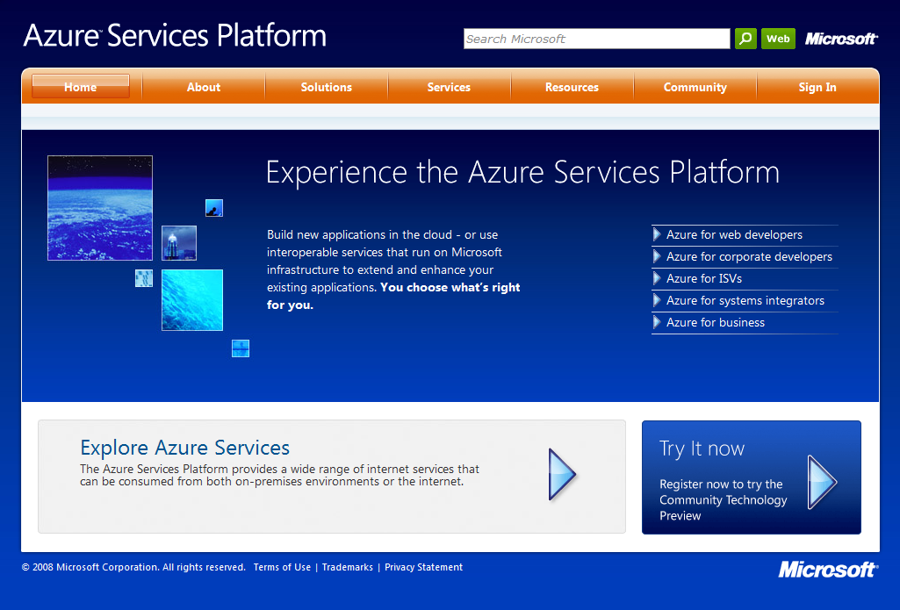
Getting started with Windows Azure: http://www.microsoft.com/azure

Slide 14
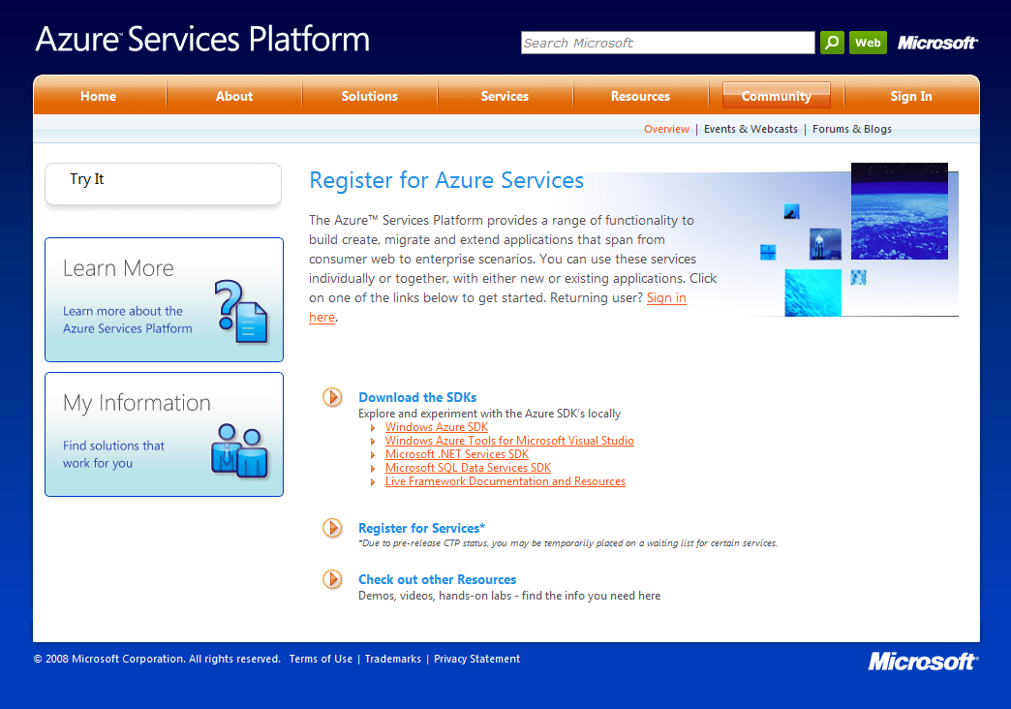
Getting started with Windows Azure:

Slide 15
Windows Azure Storage Overview
Windows Azure Storage provides three data abstractions:
Blobs– Provide a simple interface for storing named files along with metadata for the file.
Tables – Provide structured storage. A Table is a set of entities, which contain a set of properties.
Queues – Provide reliable storage and delivery of messages for an application.

Slide 16
Windows Azure Storage Goals
To let users and applications:
Access their data efficiently from anywhere at any time using simple and familiar programming API
Scale to store any amount of data for any length of time knowing that the data will not be lost.
Pay for what they use.

Slide 17
Windows Azure Storage Account
To store data securely in the cloud:
Use developer portal to create a globally unique account name and receive a 256 bit secret key.
Use the secret key to create a HMAC SHA256 signature to authenticate each request to the storage service.

Slide 18
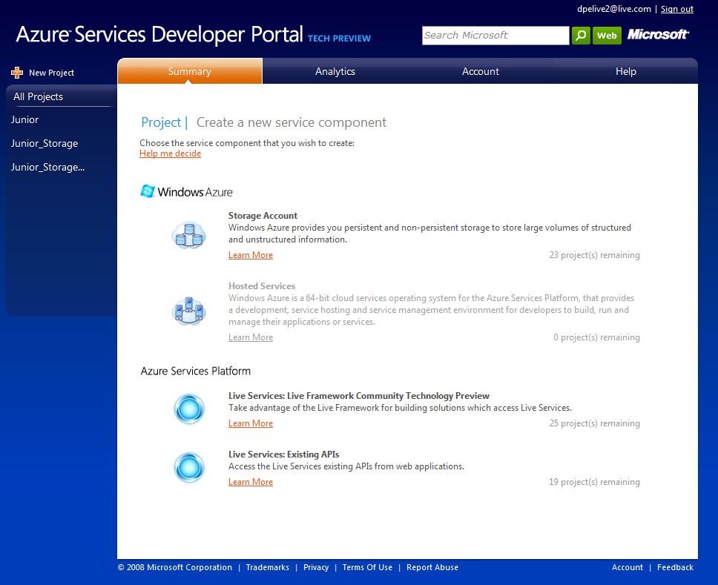
Windows Azure Storage Account Creation

Slide 19
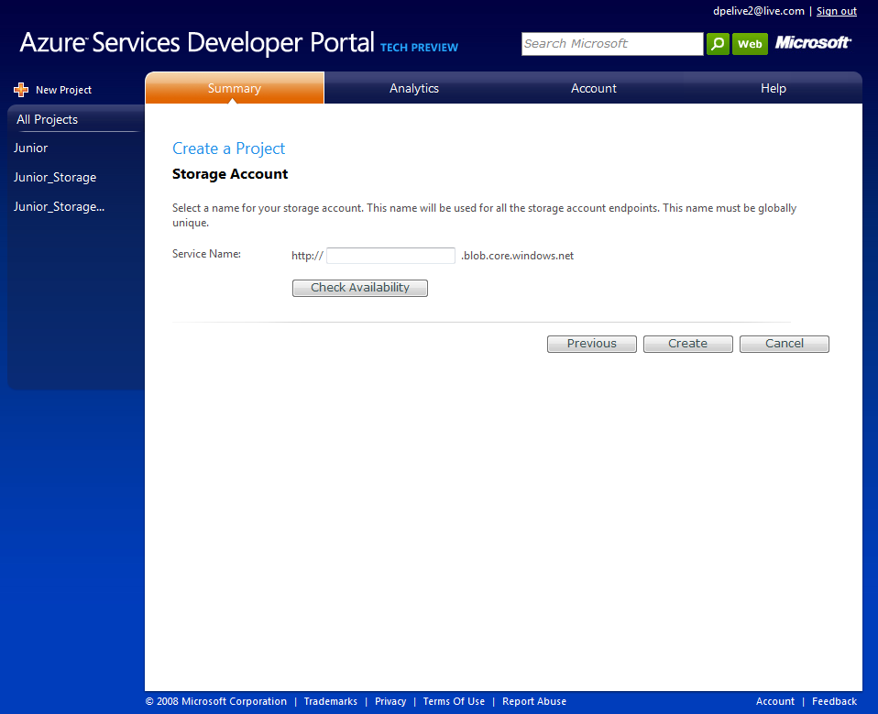
Windows Azure Storage Account Creation

Slide 20
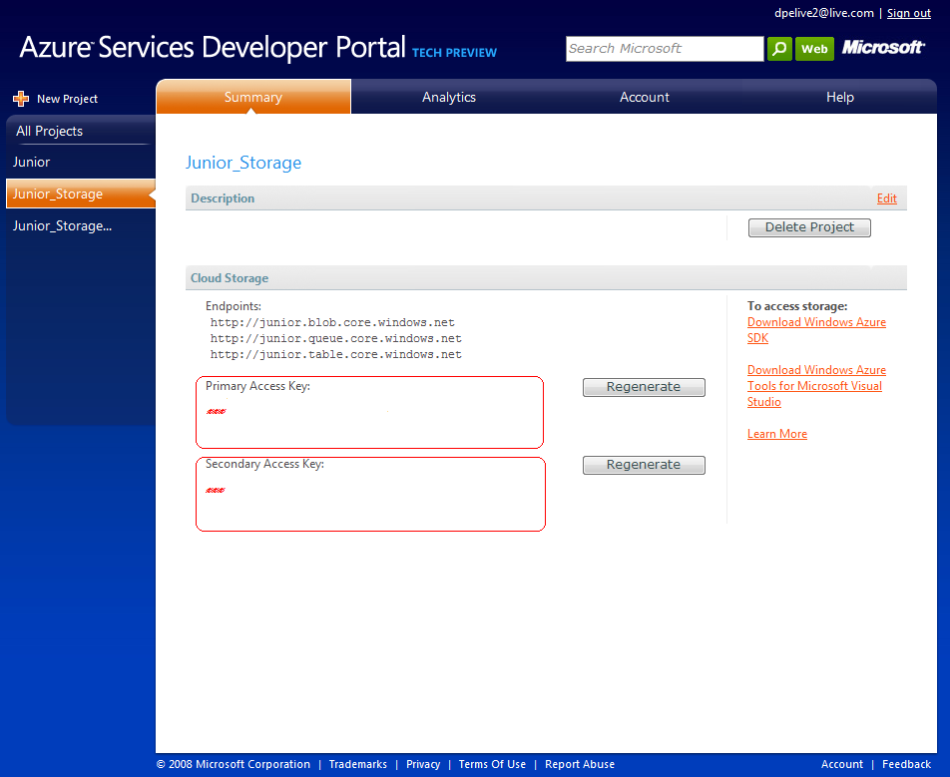
Windows Azure Storage Account Creation

Slide 21
Windows Azure Storage Development
Access to the cloud is not required to start development.
Development
Fabric
Development
Fabric
Windows Azure
Hosted Service
Development
Storage Account
Windows Azure
Storage Account
Windows Azure
Storage Account

Slide 22
Windows Azure Blob Storage
Account
Container
Blob
REST API for Blob operations. Blob URL:
http://<Account>.blob.core.windows.net/<Container>/<BlobName>
e.g. http://sally.blob.core.windows.net/pictures/img001.jpg
IMG001.JPG
pictures
IMG002.JPG
sally
movies
MOV1.AVI

Slide 23
Windows Azure Blob Feature Summary
Account can have many containers
A container
Is a set of blobs
Can have metadata (8K limit)
Boundary for access control
A blob
Stores large objects (50GB limit)
Can have metadata (8K limit)
Consists of lists of blocks providing robust blob upload
Standard REST API

Slide 24
Uploading data to Windows Azure Storage

Slide 25
Windows Azure Queues
Provide reliable message delivery
Asynchronous work dispatch
No limit on number of messages; message has 8KB limit
Access is provided via a REST API
Create, Delete, Clear, Inspect queues
Put, Get, Delete message

Slide 26
Windows Azure Queues
Account
Queue
Message
128x128, http://…
Thumbnail Jobs
256x256, http://…
Account
http://…
Indexing Jobs
http://…

Slide 27
Windows Azure Table Storage
Provides massively scalable, highly available and durable structured storage
Not a “relational database”
No joins, no maintenance of foreign keys, etc.
Familiar and easy to use API
REST, LINQ and ADO.NET Data Services

Slide 28
Windows Azure Table Storage
Account
Table
Entity
Name=…hash=…
Users
Name=…hash=…
Account
Tag=…id=…
PhotoIndex
Tag=…,id=…

Slide 29
Windows Azure Table Storage
Primary key is composite of Partition key and Row key
Partition Key Document Name | Row Key Version | Property 3 Modification Time | ….. | Property N Description
Examples Doc | V1.0 | 8/2/2007 | ….. | Committed version
Examples Doc | V2.0.1 | 9/28/2007 |  | Alice’s working version
FAQ Doc | V1.0 | 5/2/2007 |  | Committed version
FAQ Doc | V1.0.1 | 7/6/2007 |  | Alice’s working version
FAQ Doc | V1.0.2 | 8/1/2007 |  | Sally’s working version
Partition 1
Partition 2

Slide 30
Hosting our Application in Windows Azure
Windows Azure essential services for utility computing:
Scalable, available cloud storage
A rich, familiar developer experience
An open platform based on web standards
Automated service management
A powerful service hosting environment

Slide 31
Automated Service Management
You provide the code and define the rules.
The platform deploys, monitors and manages your service according to the rules. The platform deals with all hardware (servers, load balancers…).
Develop and Model
Deploy and Run
Maintain Service Health

Slide 32
Best Practice Architecture: Web Role
Public Internet
Web farm that handles request from the internet
IIS7 hosted web core hosts ASP.NET
Web Role
Load
Balancer
Storage Services

Slide 33
Best Practice Architecture: Worker Role
Public Internet
No inbound connections from the internet but can read request from queues in Windows Azure storage
Worker Role
Storage Service

Slide 34
Best Practice Architecture: Web + Worker
n
m
Web Role
Worker Role
LB
Cloud Storage (blob, table, queue)

Slide 35
Hosting our Application in Windows Azure
Let’s write the code

Slide 36
Deploying Applications to Windows Azure
Create hosted service and give it a unique name (http://simpletablesample.cloudapp.net)

Slide 37
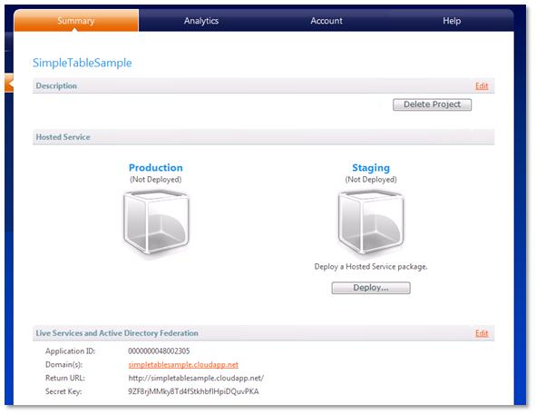
Deploying Applications to Windows Azure
Click deploy to upload packaged code and configuration.

Slide 38
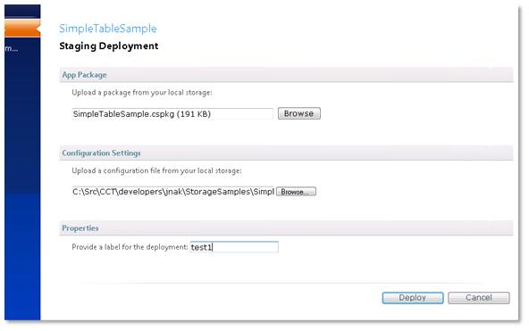
Deploying Applications to Windows Azure

Slide 39
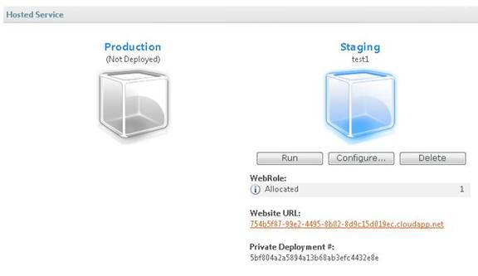
Deploying Applications to Windows Azure

Slide 40
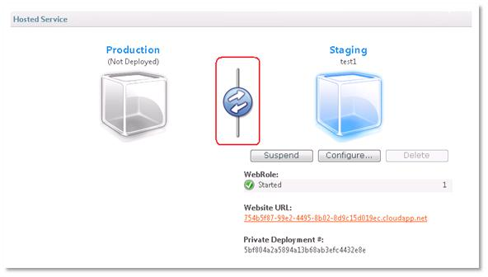
Deploying Applications to Windows Azure

Slide 41
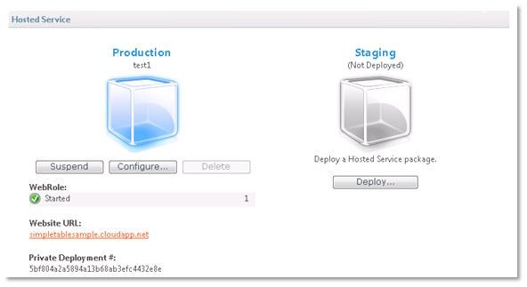
Deploying Applications to Windows Azure

Slide 42
Takeaways on Windows Azure
Provides essential services for the cloud
Designed to encourage best practices
Stateless compute + durable storage
Co-location of computation and data
Queues for asynchronous processing
Comes with a rich, familiar developer experience
An open platform
Connect outbound to any server
Open protocols and APIs on all components

Slide 43






Demo (Scenario 2)
We have a search team on the field. How can I keep track of the area they covered? How can we make them aware of each other’s locations?
Live Mesh

Slide 44
What does Azure platform offer to developers?
Your Applications
Live Services
…
Service Bus
Workflow
Database
Analytics
Identity
Contacts
Access Control
…
Reporting
…
Devices
…
Compute
Storage
Manage
…

Slide 45
Devices
Diversity of devices on the rise
My Computer → My Mesh
Data
Users’ data is everywhere, in cloud, on devices
Data is often shared
Applications
Span devices
Are getting social
People
An integral part of our digital life

Slide 46
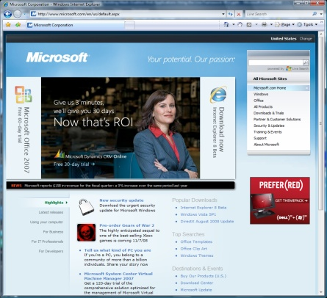
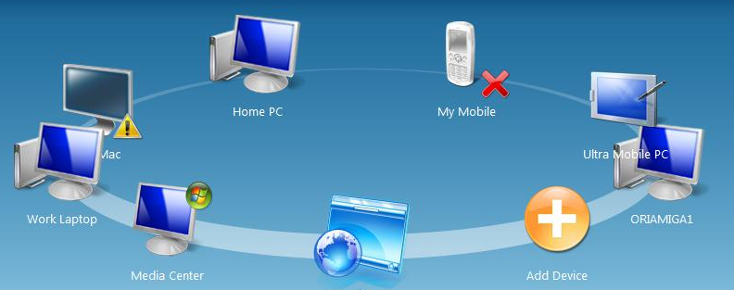
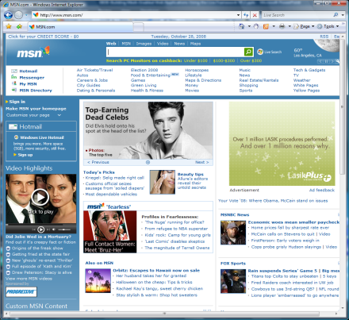


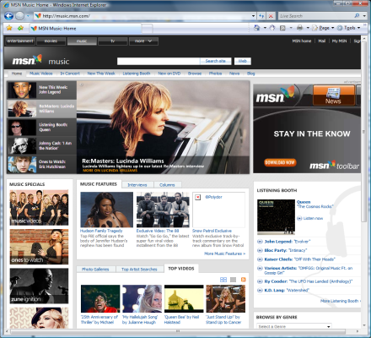
Mesh-Enabled Web Applications
Sync…
Websites
Devices & Social Mesh

Slide 47
Live Operating Environment
Live Framework’s service composition engine
Takes care of problems such as,
Offline and sync
Deployment & update
Communication
Device management, user/device presence, notifications
Exists in cloud and on all devices
All the incarnations look and feel the same
Architected the same way
Provides a unified and consistent programming model to all the apps

Slide 48
Application Types/Terminology
Live Framework supports two major application types
Mesh-Enabled Web Applications
Hosted and deployed in user’s Mesh
Takes full advantage of Live Services
Most support for Application Life Cycle
Any other Mesh-Enabled Applications that use Live Services
Covers all the other application types that don’t fit in the previous category
Use a subset of Live Services including client/cloud endpoints

Slide 49
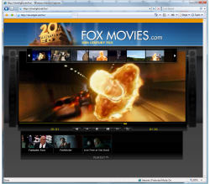

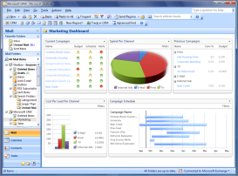
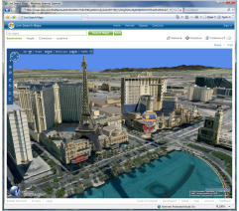
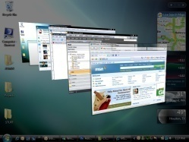

Live Operating Environment
…
http://<contacts>
[Client|Cloud]
Live Operating Environment
http://<storage>
http://<directory>
<peer devices>

Slide 50
Always Online
WL Services
WL Services
WL Services
Live Services
Live Operating Environment
(http://user.windows.net)
Web Apps
HTTP
Cloud
Device
HTTP
HTTP
HTTP
AJAX/SL/Flash
Apps
Desktop
Apps
Mobile Apps

Slide 51
Occasionally Connected
WL Services
WL Services
WL Services
Live Operating Environment
(http://user.windows.net)
Live Services
HTTP
Cloud
Device
P2P to another device
AJAX/SL/Flash
Apps
Desktop
Apps
Live Operating Environment
(http://localhost:2048)
Local Cache
HTTP
HTTP

Slide 52
Silverlight Integration
public Page()
{
InitializeComponent();
MeshApplicationService meshApp = Application.Current.GetMeshApplicationService();
meshApp.LoadCompleted += new EventHandler(app_Load);
meshApp.Load();
}
void app_Load(object sender, EventArgs e)
{
MeshApplicationService meshApp = Application.Current.GetMeshApplicationService();
RenderContent(meshApp);
}
void RenderContent(MeshApplicationService meshApp)
{
//Accessing Mesh
myMesh = meshApp.LiveOperatingEnvironment.Mesh;
//Accessing the Application Mesh Object
meshApp.Resources.Title = "My Title";
}

Slide 53
JavaScript Libraries
MeshApp.run = function MeshApp$run() {
Microsoft.LiveFX.MeshApplication.loadAsync(windows.location.hostname, Delegate.create(null, function(meshApplicationContext)
{
if (meshApplicationContext.state !== Microsoft.LiveFX.OperationState.Success)
{
MeshApp._showError('MeshApplication Load Failed');
}
else
{
var meshApplication = meshApplicationContext.resource;
meshApplication.get_runtimeEndpoint().get_mesh().loadAsync
(Delegate.create(null, function(meshOperationContext)
{
MeshApp._onLoadMesh(meshOperationContext);
}));
}
}));

Slide 54
From LINQ to HTTP request
MeshObject GetMeshObjectByTitle(string title) {
MeshObject meshObject = (from mo in mesh.CreateQuery<MeshObject>() where mo.Resource.Title == title select mo).FirstOrDefault<MeshObject>(); return meshObject;
}
GET https://user-ctp.windows.net/V0.1/Mesh/MeshObjects/{meshObjectID}/DataFeeds/?$filter=(Title eq ‘title provided’)

Slide 55
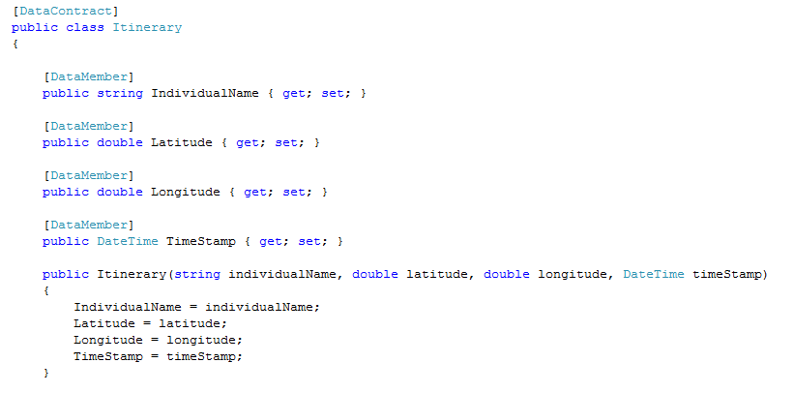
Custom Objects

Slide 56
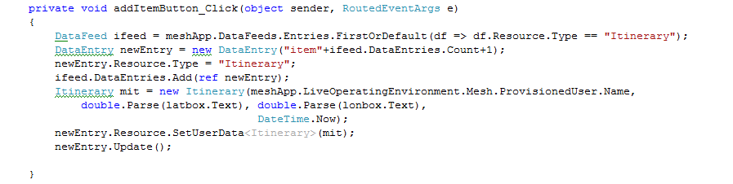
Adding Custom Objects to Mesh
Data entries can also handle files using …MediaResource methods
e.g. DataEntry.ReadMediaResource(System.IO.Stream);

Slide 57

Demo (Scenario 3)
How can I keep record of their locations and contact info, search for people in a certain area?

Slide 58
What does Azure platform offer to developers?
Your Applications
Live Services
…
Service Bus
Workflow
Database
Analytics
Identity
Contacts
Access Control
…
Reporting
…
Devices
…
Compute
Storage
Manage
…

Slide 59
Scalable, Available Data Services Storage and Database Services
Windows Azure Storage
SQL Data Services
Essential storage service in the cloud
Provides a core set of non-relational storage and retrieval abstractions at massive scale
Database service in the cloud
Extends the rich capabilities of the SQL data platform to the cloud at scale
Relational data processing over structured and unstructured data
Integrate with key data platform capabilities – e.g. Data Analytics, Reporting, ETL

Slide 60
Data Model And ACE Concepts
Authority
Container
Entity
Unit of geo-location and billing
Tied to DNS name
Collection of Containers
~ DB Instance
Unit of Consistency
Scope for Query and Update
Collection of Entities
~ DB Table
Unit of Storage
Property Bag of Name:Value pairs
No Schema Required. Values typed.
BLOB support
~ Table row

Slide 61
Concepts Entity
Standard metadata properties
Id : Unique within container
Kind : User defined typename for the entity. No schema enforced.
Version : Increasing counter upon updates to entity
Flexible properties
Bag of Name, Type, Value tuples
string, numeric, boolean, datetime, base64Binary
Same name can be mapped to multiple values
Entities of same kind may have any bag of names. Application responsible for consistent typing if needed.
BLOB entities
Binary objects. content-type & content-length metadata

Slide 62
Concepts Entity
Property |  | Type | Value
Metadata | ID | EntityId | C5
 | Kind | EntityKind | Contact
FlexProps | Name | String | Bugs Bunny
 | Phone | Numeric | 4088006000
 | Role | String | PostDoc
 | FieldWork | Boolean | true
Different Kinds
Different Instance Types
Property | Type | Value
ID | EntityId | a11bb064-e268
Kind | EntityKind | Location
ContactID | String | C5
Latitude | Numeric | 39.1999
Longitude | Numeric | -123.1828
Role | Numeric | 7
Property | Type | Value
ID | EntityId | a11bb064-e268
Kind | EntityKind | Location
ContactID | String | C5
Latitude | Numeric | 39.1999
Longitude | Numeric | -123.1828
Role | Numeric | 7
UpdateTime | DateTime | 1st January, 2008
Additional Property

Slide 63
CRUD Operations
REST & SOAP APIs to perform Create, Read, Update and Delete operations
Authorities, Containers & Entities referenced by unique URI
https://escience2008.data.database.windows.net/v1/
https://escience2008.data.database.windows.net/v1/ScienceTeam
https://escience2008.data.database.windows.net/v1/ScienceTeam/b54
Entities, properties mapped to simple XML schema
Basic authentication using HTTPS

Slide 64
REST API: Create
Create entity
Target URI (scope) is parent container. E.g. https://escience2008.data.database.windows.net/v1/ScienceTeam
HTTP POST operation with entity XML as body
<Contact>
<s:Id>4d270293-9c23-4a24-8a90-0041b872b796</s:Id>
<CId xsi:type="x:string">C1</CId>
<Name xsi:type="x:string">Bugs Bunny</Name>
<Role xsi:type="x:string">PI</Role>
<Phone xsi:type="x:decimal">4150001000</Phone>
<FieldWork xsi:type="x:boolean">true</FieldWork>
</Contact>

Slide 65
Demo: Calling REST Create using C#

Slide 66
REST API: Get
Create entity
Target URI (scope) is entity. E.g. https://escience2008.data.database.windows.net/v1/ScienceTeam/
4d270293-9c23-4a24-8a90-0041b872b796
HTTP GET operation with empty body
<Contact>
<s:Id>4d270293-9c23-4a24-8a90-0041b872b796</s:Id>
<s:Version>531601</s:Version>
<CId xsi:type="x:string">C1</CId>
<Name xsi:type="x:string">Bugs Bunny</Name>
<Role xsi:type="x:string">PI</Role>
<Phone xsi:type="x:decimal">4150001000</Phone>
<FieldWork xsi:type="x:boolean">true</FieldWork>
</Contact>

Slide 67
REST API Mapping between HTTP Verb & operation
 | Authority | Container | Entity
Create HTTP POST | Root URI Authority props | Authority URI Container props | Container URI Entity props
Read HTTP GET | Authority URI Empty | Container URI Empty | Entity URI Empty
Query HTTP GET | Root URI + query string Empty | Authority URI + query string Empty | Container URI + query string Empty
Update HTTP PUT | Authority URI Updated Authority props | Container URI Updated Container props | Entity URI Updated Entity props
Delete | Authority URI Empty | Container URI Empty | Entity URI Empty

Slide 68
BLOBs
Can get metadata of BLOB or the binary content
Use HTTP Accept header to control response
application/x-ssds+xml returns BLOB metadata
*/* returns BLOB binary
Anything else returns the binary only if the content type matches stored content type

Slide 69
Authentication And Authorization
Basic authentication – username and password
Integrate with .NET Access Control Services for richer authentication models
Basic Authentication
Claims based access control
Role based authorization – Future

Slide 70
SDS Query language
Textual query language through web-service head, passed in as literal text string
Language patterned after C# LINQ syntax from e in entities where e.Kind == “Contact” && e[“Role”] == “PostDoc” select e
Operator semantics handles lack of schema contract
e[“Role”] could be number in one entity and string in another
e[“Role”] == “PostDoc” means look for instances where Role is a string and has value “PostDoc”; i.e., type inference using literal syntax
Query supported over metadata and data properties
All fields are automatically indexed

Slide 71
Join in SLINQ
Finally, A Data Service With JOIN
from c in entities.OfKind(“Contacts”)
from l in entities.OfKind(“Location”)
where
c.CId == l.CId &&
l[“Latitude”]>38 && l[“Latitude”] < 41
orderby l[“UpdateTime”] descending
select c.Take(1)

Slide 72
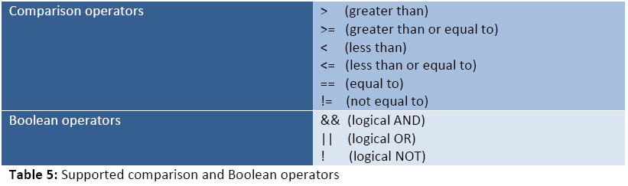
Operators and functions
KindOf()
Matches the ‘s:Kind’ metadata field
Take()
Limits the number of results to be returned
orderby [descending]
Sorts the entities on a property value

Slide 73

SQL Services
SQL Data Services Front End
REST / SOAP
REST / SOAP
REST / SOAP
REST / SOAP
REST / SOAP
REST / SOAP
REST / SOAP
SDS Runtime
SDS Runtime
SDS Runtime
SDS Runtime
SDS Runtime
SDS Runtime
SDS Runtime
Data Access Lib
Data Access Lib
Data Access Lib
Data Access Lib
Data Access Lib
Data Access Lib
Data Access Lib
Data Cluster
SQL Data Services Back End
Master Cluster
SQL Server
SQL Server
SQL Server
SQL Server
SQL Server
SQL Server
SQL Server
Distributed Data Fabric
Distributed Data Fabric
Distributed Data Fabric
Distributed Data Fabric
Distributed Data Fabric
Distributed Data Fabric
Distributed Data Fabric
Mgmt. Services
Mgmt. Services
Mgmt. Services
Mgmt. Services
Mgmt. Services
Mgmt. Services
Mgmt. Services

Slide 74
Data And Master Nodes
SDS - Back-end
SDS - Reliable Master Cluster Manager
SQL Server
Partition Manager
Partition Placement Advisor
SQL Server
Global Partition Map
Leader Elector
Database
P1
Distributed Data Fabric
P2
P3
SDS – Data Nodes
P4
Data Node 101
Data Node 102
Data Node 103
Data Node 104
Data Node 105
P5
P6
P1
P2
S1
S5
P3
S2
P5
S2
S6
S5
P6
S1
S6
P4
S4
S3
S4
P3

Slide 75

Data Partitioning
Request for
Container X
Extreme scale is achieved through partitioning data into containers
SDS apps are container-aware
Requests include a target container
Implementation is opaque to users
Containers – unit of consistency
Replicated for reliability and HA
Reconfigured during failover
Used for load balancing
Trade off app transparency and latency for scale, throughput and better TCO
Rich SQL-like operations within a container
Some operations cross-containers
Container size limitations
SDS Front End
Fetch container map
Container look-up
Connect to BE
server holding
Container X
Master
Cluster
Manager
SDS Back End
Container X

Slide 76
Data Consistency
Data needs to be replicated within a replica set for high availability
All clients need to see the same linearized order of read and write operations
Read-Write quorums are supported and are dynamically adjusted
Replica set is dynamically reconfigured to account for member arrivals and departures

Slide 77
Application Design Considerations
Designing for scale using multiple containers
Entity and Containers limited in size
Number of properties/size of entity (MB)
Number of entities within a container (GB)
Each container has limited IOPs and CPU capacity
Designing for latency
Code (biz logic) has higher latency to data service
Batching to reduce service request latency
Use of authorities to provide geo-location

Slide 78
Application Design Considerations
Containers are scoped to nodes in the SDS backend
Spread your data out amongst many containers for best performance
Process your queries in parallel across containers for best performance
SDS provides an immediate consistency model
Use appropriate versioning semantics to prevent unwanted data overwrites
MatchType property in SOAP
IfMatch header in REST
By using Windows Azure, your middle tier is located closer to your data

Slide 79
eScience Applications using SDS Trident Registry using SDS
Trident Scientific Workbench (See next tutorial!)
Service and Metadata Registry in the Cloud
SDS is one of the data storage backends
Reduce installation pre-requisite
Get power of SQL without requiring SQL Server instance
Flexible data model to describe different types of resource
Jobs, Compute Nodes, workflows, data

Slide 80
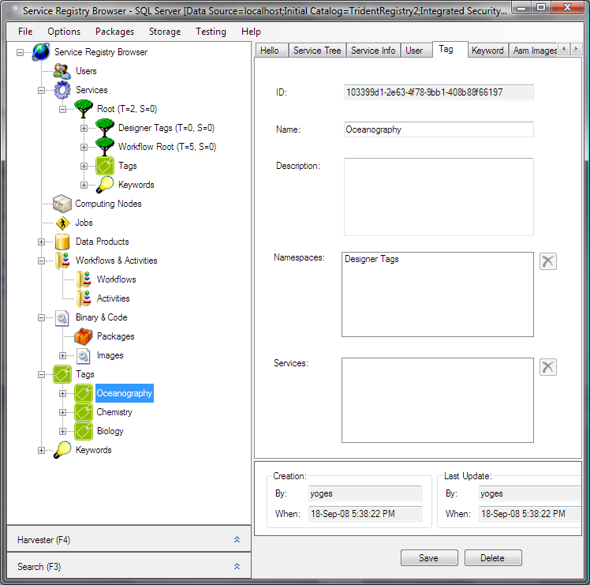

Slide 81
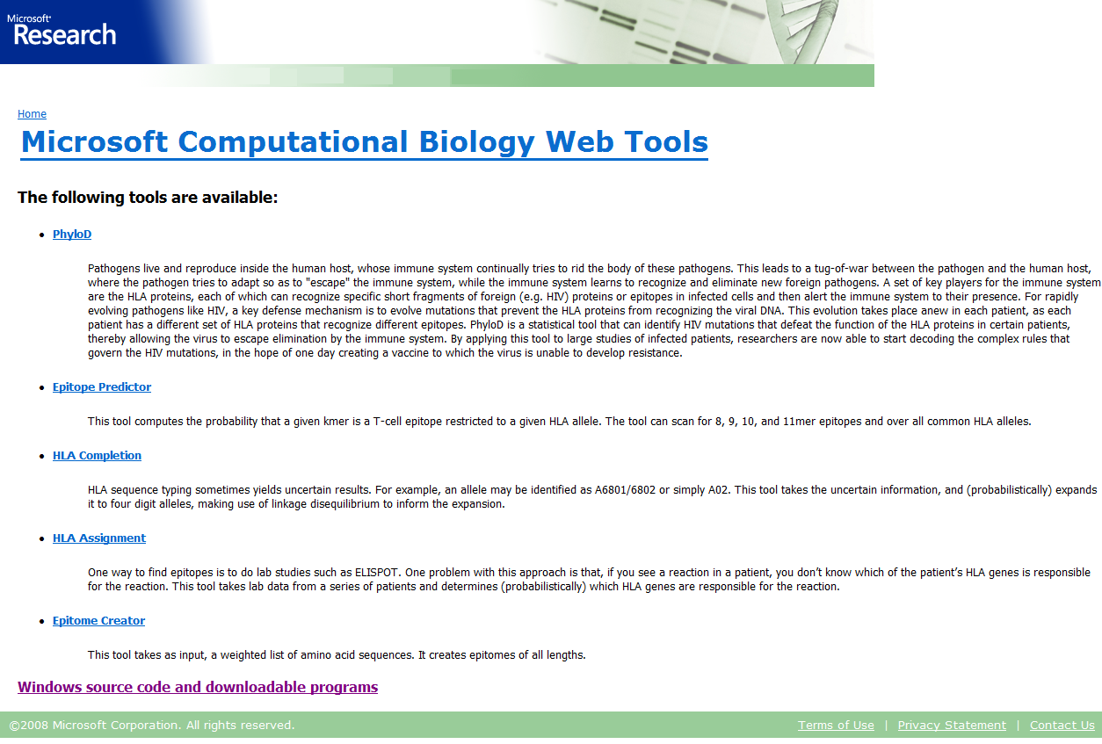
Computational Biology Tools in Windows Azure
A set of specialized tools available publically available on CodePlex
and as a web application

Slide 82
Computational Biology Tools in Windows Azure
Sub-set of the tools ported to Windows Azure
Worker role accepting request from web role and desktop app
Data & computation state shared via Blob and Table between worker and trusted client.
Lessons
Existing code easy to port (e.g. file operations well insulated)
Beware of binary serialization in medium trust
Had to disable MS Parallel Extensions for trust reasons
32 bit vs 64 bit
Did not address redirecting log information

Slide 83
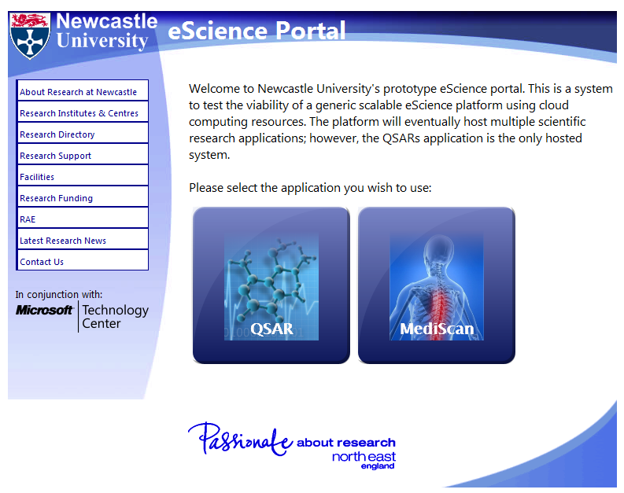
QSAR Modeling in the cloud
Learn more in tomorrow’s keynote by Prof. Paul Watson

Slide 84
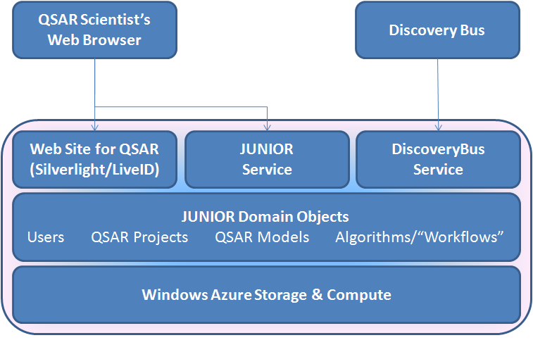
QSAR Modeling in the cloud
Finishing 3-week proof-of concept addressing two use-cases:
Demonstrate the notion of a “Cloud Top” providing a collaborative environment for QSAR modeling (make predictions, build models, contribute algorithms)
Leverage computing power offered by the cloud to scale QSAR computations (DiscoveryBus – Azure integration).

Slide 85
In Conclusion
Azure Services Platform provides an OS and rich services for the cloud
Windows Azure, SQL Services, Live Services and more
Its benefits are:
Easy developer on-ramp to the cloud
Enables agile and rapid results at scale
Standard-based compatibility
www.microsoft.com/azure

Slide 86

© 2008 Microsoft Corporation. All rights reserved. Microsoft, Windows, Windows Vista and other product names are or may be registered trademarks and/or trademarks in the U.S. and/or other countries.
The information herein is for informational purposes only and represents the current view of Microsoft Corporation as of the date of this presentation. Because Microsoft must respond to changing market conditions, it should not be interpreted to be a commitment on the part of Microsoft, and Microsoft cannot guarantee the accuracy of any information provided after the date of this presentation. MICROSOFT MAKES NO WARRANTIES, EXPRESS, IMPLIED OR STATUTORY, AS TO THE INFORMATION IN THIS PRESENTATION.

